Slide 1
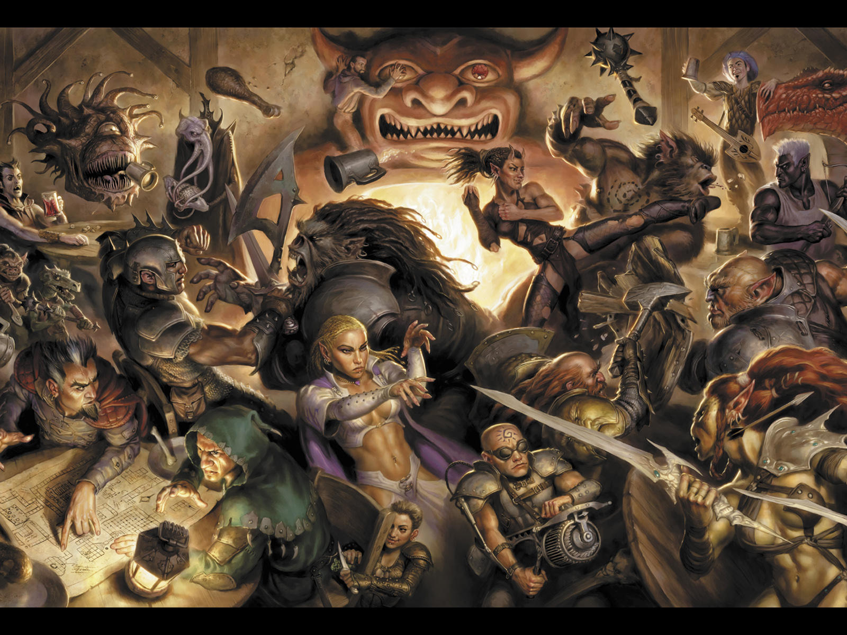
Dungeon Organizer
Gnolls
Gnolls

Slide 2
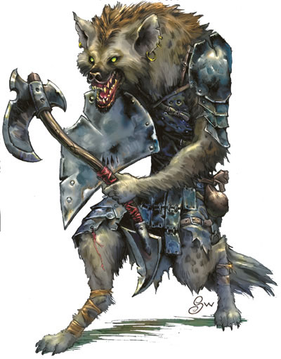
Project Overview
Development of an interactive website for players of Dungeons & Dragons 3.5, that allows for:
Creation/Management of Character Sheets.
Searching for spells, items, races, classes, feats, etc.
Creation of parties comprised of a Dungeon Master and players.
Conversation and long distance play via a Bulletin Board.

Slide 3
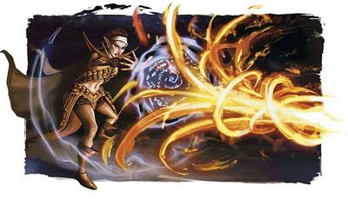
Team Members
Jacqueline Munroe - Project Lead, Website developer
Michael Dunton - Scrum Master, Database/ Forum developer
Toyanne Bennett - Documentation, Forum Developer
Widler Rislin - Database Programmer
Russell Stephenson - Programmer, Normalize data/ Database population

Slide 4
Problem Statement
The motivation behind the project is the lack of Dungeons and Dragons websites dedicated to providing a personal spellbook and character creation for forum based play with players across the country. Using this website would open communication between people that share an interest in D&D that would otherwise not likely be established.

Slide 5
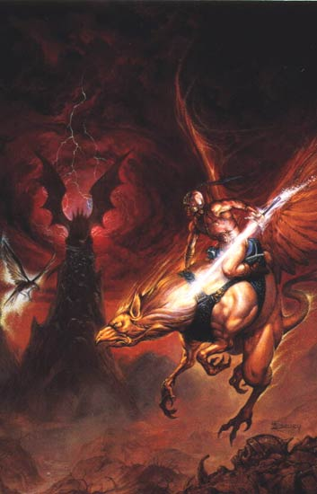
Project Requirements Overview
Developers to finish the project
Administrator to maintain the website and forum
Dedicated server to keep the website and database running
A community to contribute to the longevity of the database
Database needs to be secure

Slide 6
Problems Encountered
Time to work on the database around each of our schedules.
Finding/ Normalizing the data for database population. We wanted more information for each spell but ran out of time to normalize the data.
Dividing the workload evenly and assigning roles.
The need to change things mid semester, i.e. no mobile app, changing database schema.
Communication was only a small issue.
Transferring all of our final documents to the remotely hosted site, was a major problem.

Slide 7
Steps to Overcome Problems
We typically did work on our own time and met for scrums.
We found data, put it into a .txt file and changed things such that it would be easy to tokenize a line for each spell. We had to distinguish between what we wanted to do and what we had time to do.
We changed and adopted new roles as the project progressed.
Change is sometimes necessary due to time constraints.
We decided to not spend extra time with the hosted site and instead use a server run by one of the team members.

Slide 8
Overview of the Design
Two separate databases:
Main website
Spells, Races, Classes and their attributes
Characters and their associated spellbooks comprised of spells
Bulletin board - phpBB
User information used for login to all aspects of site (reuse of code)
Everything else needed to maintain the forum

Slide 9
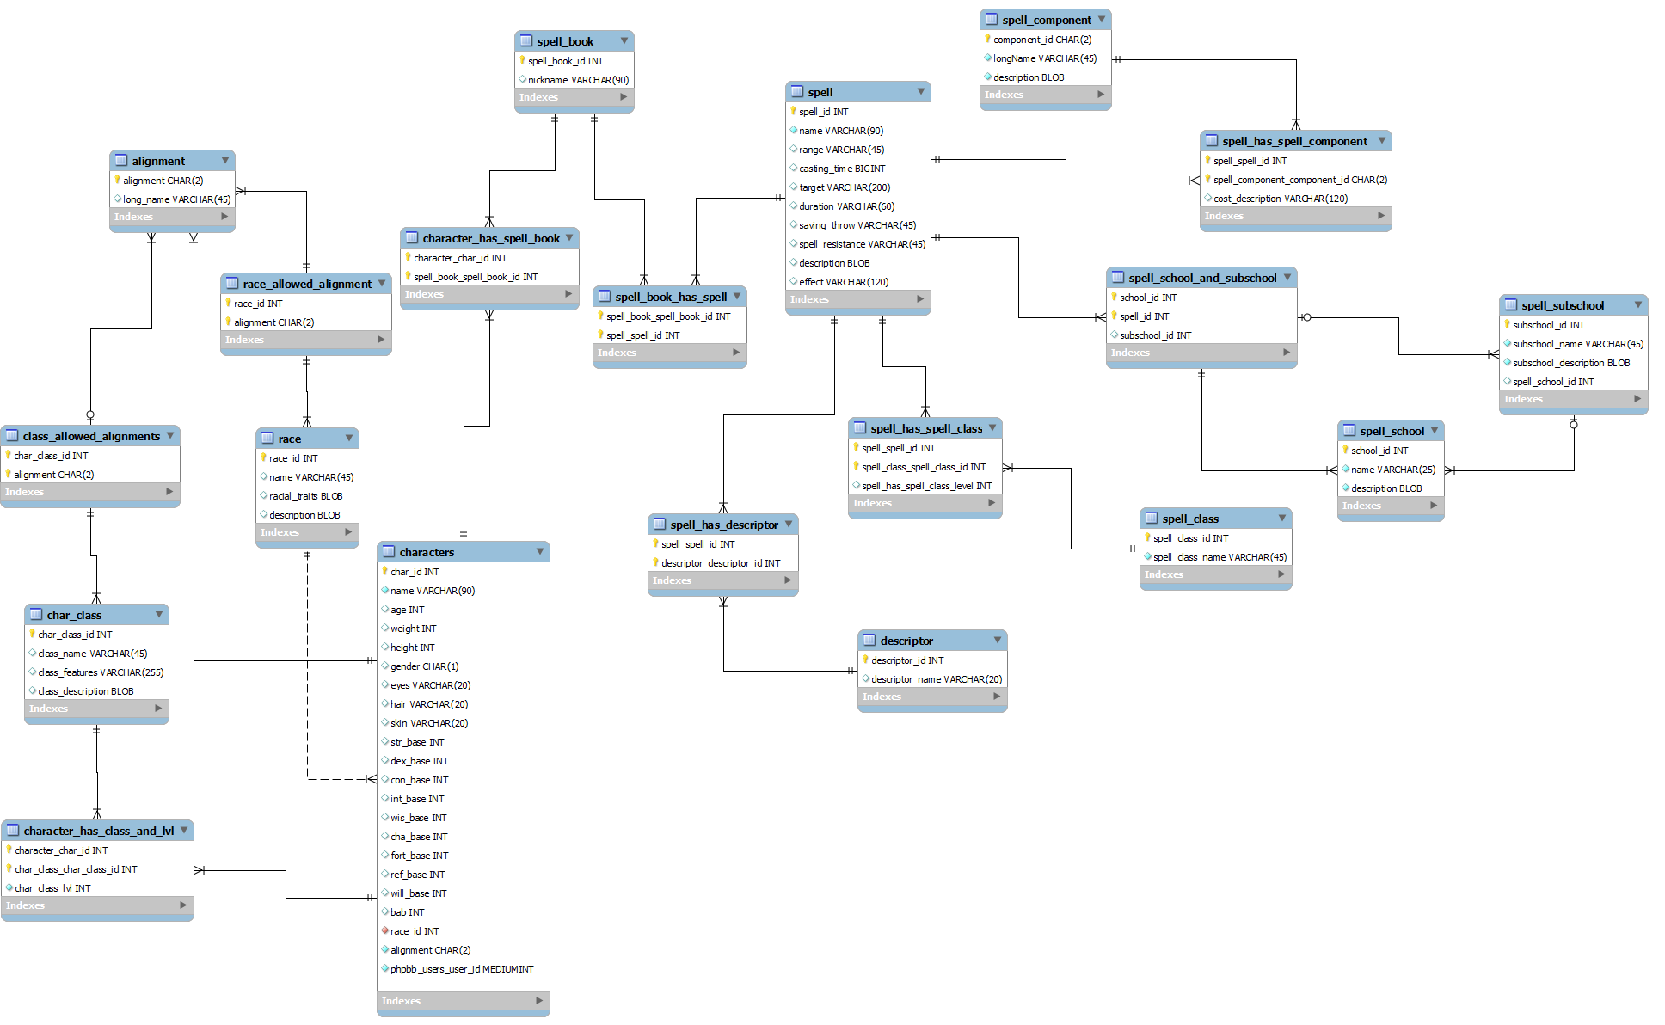
Schema for Spells and Characters
Notes:
When on this slide (the image is a link) click the image and use the mouse and scroll wheel to show everything.

Slide 10
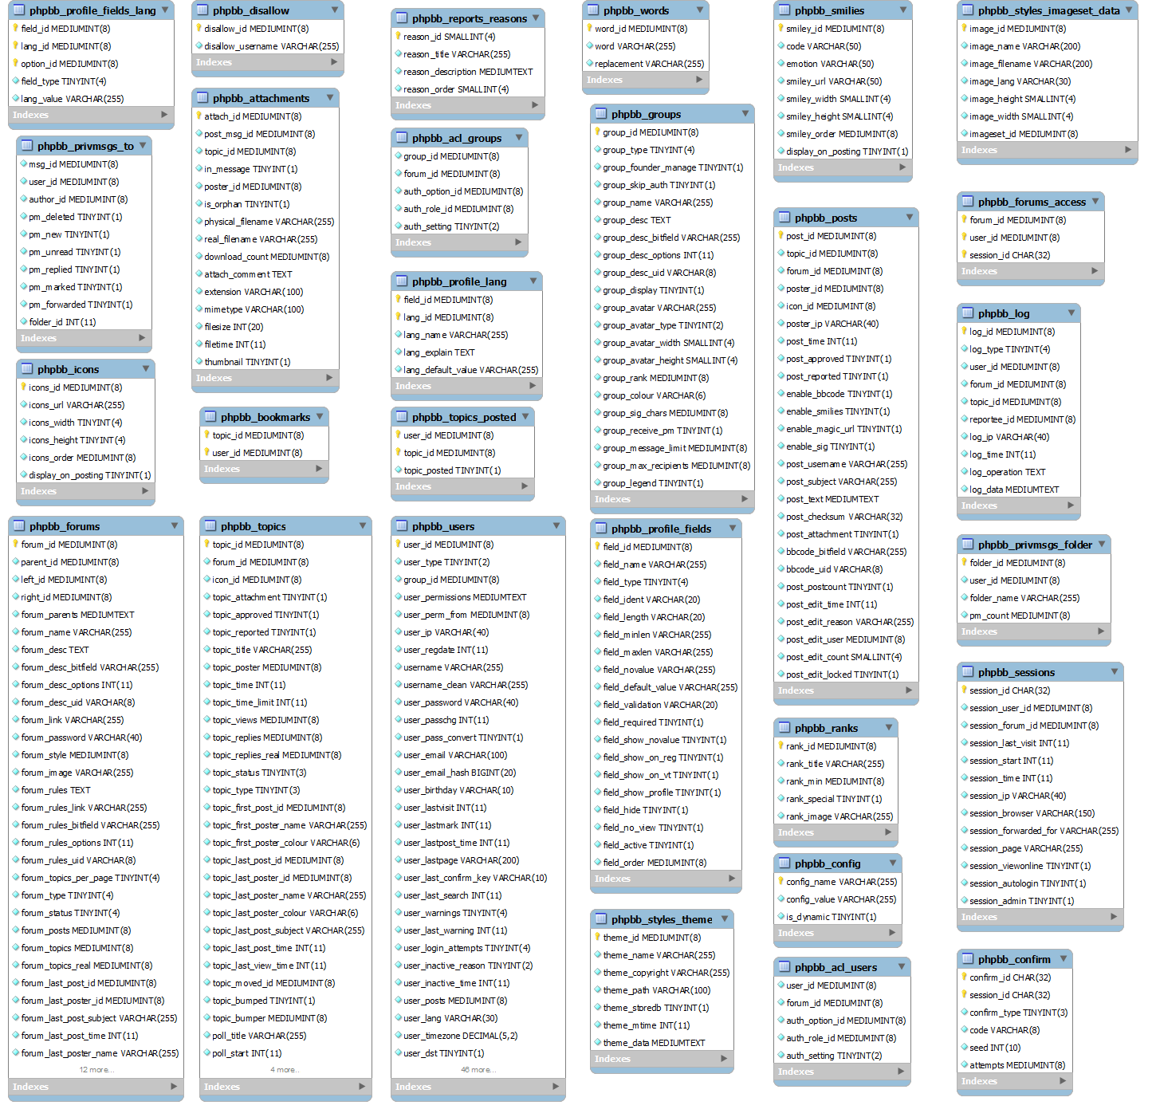
Schema for phpBB
Notes:
When on this slide (the image is a link) click the image and use the mouse and scroll wheel to show everything.

Slide 11
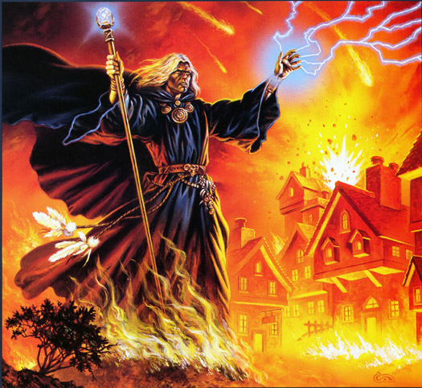
Demonstration

Slide 12
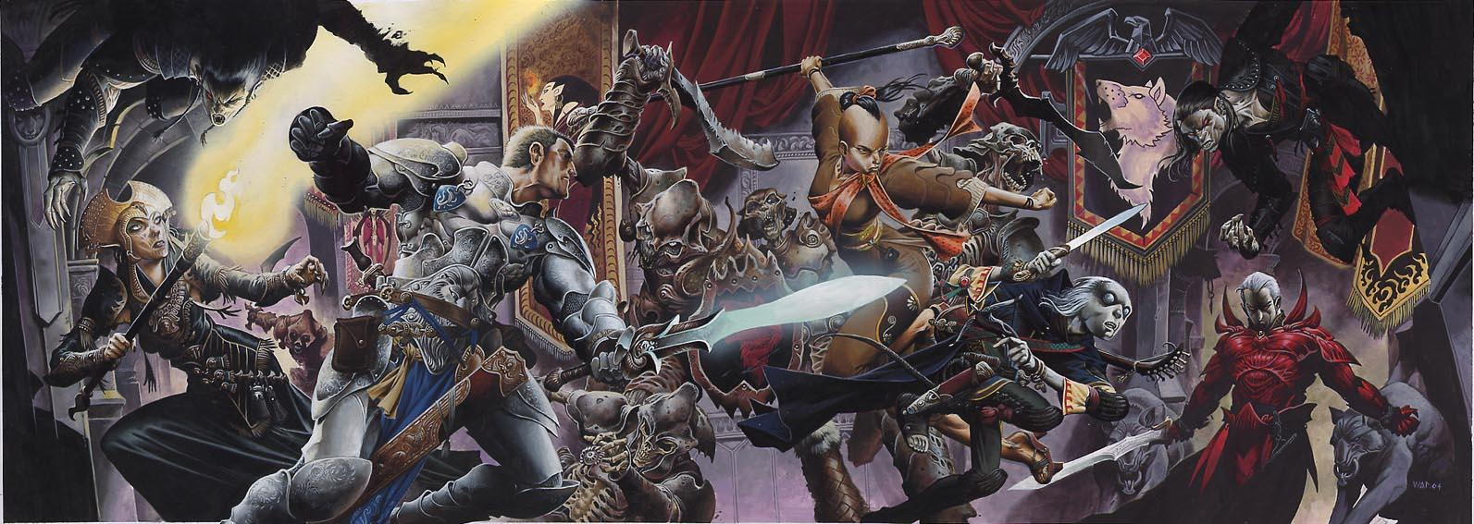
Future Work Recommendations
Add a mobile app.
Advertise the website to create a community.
Offer the ability to create multiple characters.

Slide 13
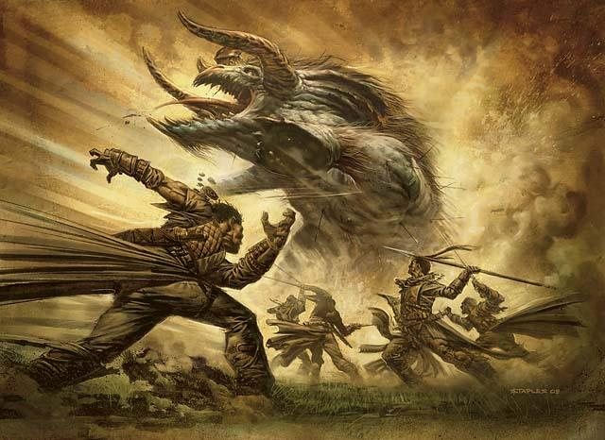
Conclusion
We didn't get as far as we would have liked and we had to scrap ideas along the way but we did deliver a functional product.
Projects change over time due to time constraints.
Medium sized group projects can be difficult due to communication and scheduling in a classroom setting.

